Slide 1
Requirement Modeling: Use Case Diagram
Md. Mohaiminul Islam
Lecturer, CSE
University of Asia Pacific

Slide 2
Introduction
Use-cases are descriptions of the functionality of a system from a user perspective.
❖
Depict the behaviour of the system, as it appears to an outside user.
Describe the functionality and users (actors) of the system.
❖
❖
Show the relationships between the actors that use the
the
system, the use cases (functionality) they use, and
relationship between different use cases. Document the scope of the system.
❖
❖
Illustrate the developer’s understanding of the user’s requirements.

Slide 3
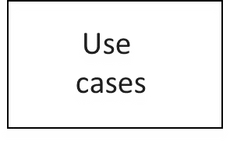
Use Case Diagram, purpose
Class diagrams
Activity diagrams
Requirements document
(text in natural language)
Sequence diagrams
Statechart diagrams
•
Use case models are developed at different levels of abstraction
system, system component, or a class.
Use case modelling is an iterative and incremental process.
If user requirements change, the changes should be made in all the
•
affected documents.

Slide 4


Use Case diagrams, basic UML notation
Use Case: A Use Case is a description of a set of interactions between a user and the system.
Components of use case diagram:
▪
▪
▪
▪
Actor Use case
System boundary Relationship
use case name
use case name
use case name

Slide 5
Actor
Actor is someone interacting with use case
(system function). Named by noun.
Similar to the concept of user, but a user can play different roles;
(example: a prof. can be instructor and researcher – plays 2 roles with two systems).
Name
Actor triggers use case.
Actor has responsibility toward the system (inputs), and Actor have expectations from the system (outputs).
13

Slide 6
ACTOR
Actors can be human or automated systems.
Actors are not part of the system.
UML notation for actor is stickman, shown below.
Student
Faculty
Employee

Slide 7
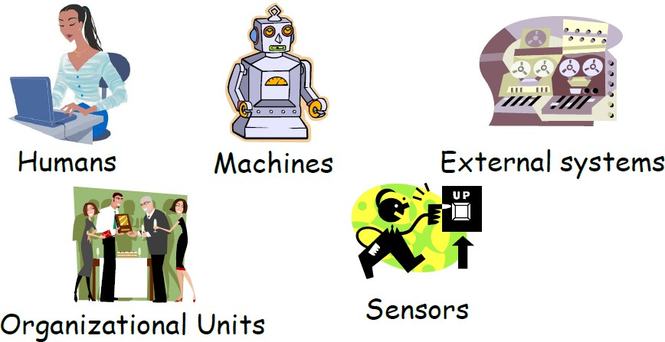
Finding Actors
External objects that produce/consume data:
Must serve as sources and destinations for data
Must be external to the system

Slide 8
Primary and Secondary Actors
•
Primary Actor
Acts on the system
Initiates an interaction with the system
Uses the system to fulfill his/her goal
e.g. the employee receiving the paycheck
Secondary Actor
Is acted on/invoked/used by the system
Helps the system to fulfills its goal
Something the system uses to get its job done
e.g. the warehouse receiving a packing slip
•

Slide 9
USE CASE
What is USE case?
A use case is a pattern of behavior, the system exhibits
The use cases are sequence of actions that the user takes on a system to get particular target
USE CASE is dialogue between an actor and the system.
Examples:
Add a course

Slide 10
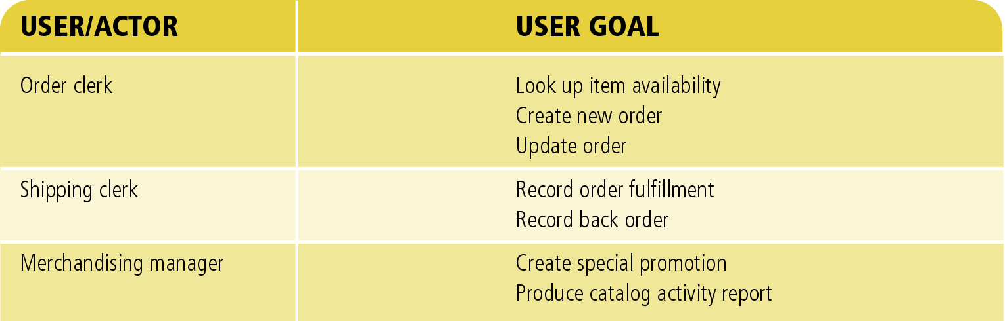
Use Case
Do something
System function (process – automated or manual).
Named by verb.
Each Actor must be linked to a use case, while some use cases may not be linked to actors.
= Use Case
14

Slide 11
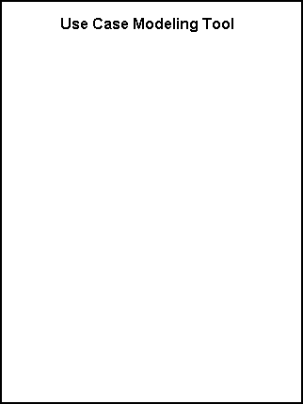
System Boundary
■
It is shown as a rectangle.
It helps to identify what is external versus internal, and what the responsibilities of the system are.
The external environment is represented only by actors.
■
■

Slide 12
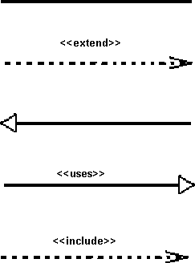
Relationship
•
•
Relationship is an association between use case and actor. There are several Use Case relationships:
■
Association
■
Extend
■
Generalization
■
Uses
■
Include

Slide 13
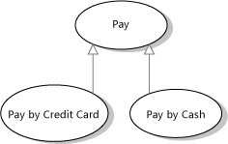
1. Generalization
Generalization is a relationship between a general use case and a more specific use case that inherits and extends features to it
use cases that are specialized versions of other use cases
It is shown as a solid line with a hollow arrow point

Slide 14
1. Generalization
The child use case inherits the behavior and meaning of the parent use case.
The child may add to or
override the behavior of its parent.
parent
child
18

Slide 15
1. Generalization
registration
non-graduate
registration
graduate
registration
19

Slide 16
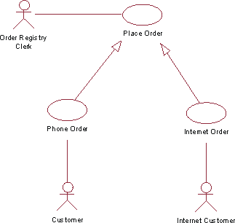
1. Generalization
The actor Order Registry Clerk can instantiate the general use case Place Order.
Place Order can also be specialized by the use cases Phone Order or Internet Order.

Slide 17
2. Extend
base
<<extend>>
extending
The base use case implicitly incorporates the behavior of another use case at certain points called extension points.
The base use case may stand alone, but under certain conditions its behavior may be extended by the behavior of another use case.
It is shown as a dotted line with an arrow point and labeled <<extend>>
27

Slide 18
2. Extend
Enables to model optional behavior or branching under conditions.
<< extend>>
Register New User
Login

Slide 19
2. Extend
Extend relationship – linking an optional use case to a standard use case.
Example: Register Course (standard use case) may have Register for Special Class (extend use case) – class for non-standard students, in unusual time, with special
topics, requiring extra fees…).
The optional UC extends the standard UC
Standard use case can execute without the extend case
→ loose coupling.
29

Slide 20
3. Include
base
<<include>>
included
The base use case explicitly incorporates the behavior of another use case at a location specified in the base.
The included use case never stands alone. It only occurs as a part of some larger base that includes it.
They are shown as a dotted line with an open arrow and the key word <<include>>
22

Slide 21

3. Include
Include relationships insert additional behavior into a base use case
use cases that are included as parts of other use cases.
Enable to factor common behavior.

Slide 22
3. Include
Include relationship – a standard case linked to a
mandatory use case.
Example: to Authorize Car Loan (standard use case),
a clerk must run Check Client’s Credit History (include use case).
The standard UC includes the mandatory UC (use the verb to figure direction arrow).
Standard use case can NOT execute without the include case → tight coupling .
24

Slide 23
3. Include
Enables us to avoid describing the same flow of events several times by putting the common behavior in a use case of its own.
updating grades
<<include>>
verifying student id
output generating
<<include>>
עדימ תוכרעמ חותינ
23

Slide 24
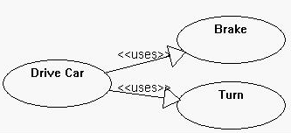
4. Uses
When a use case uses another process, the relationship can be shown with the uses relationship
This is shown as a solid line with a hollow arrow point and the <<uses>> keyword

Slide 25
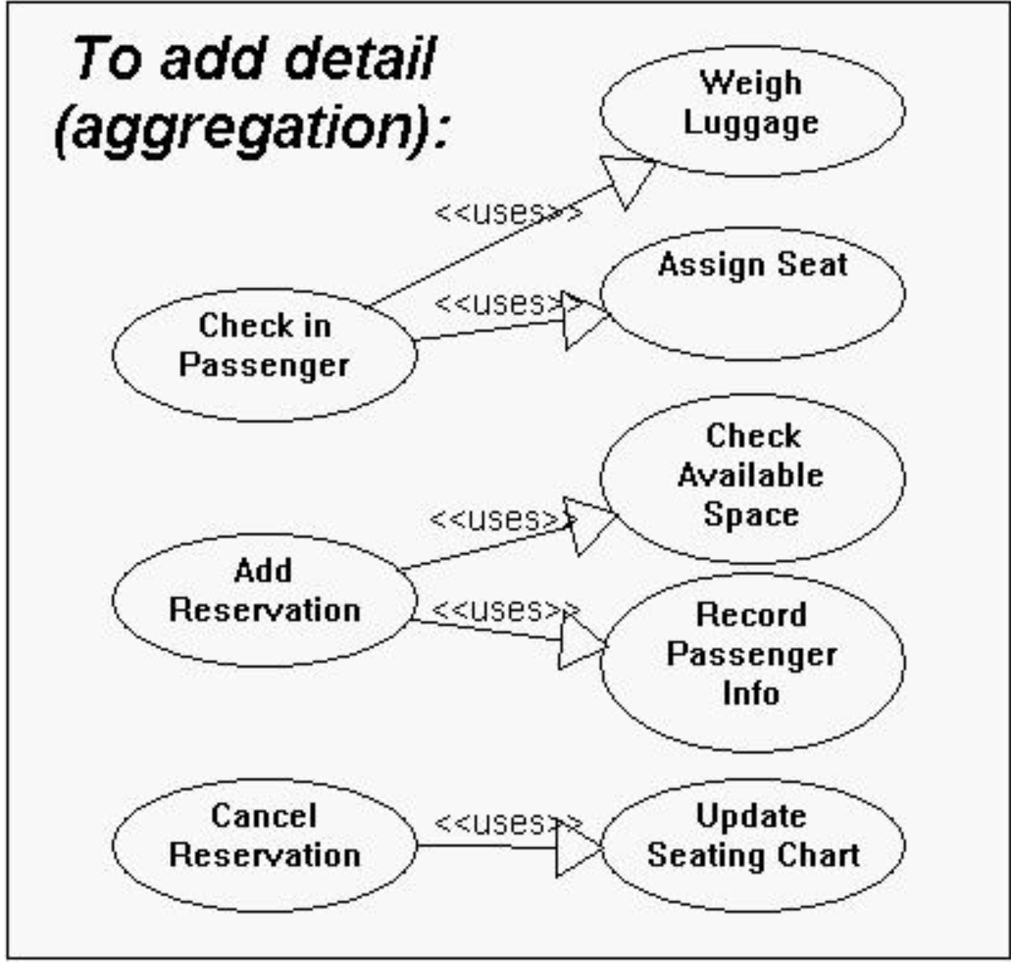
4. Uses

Slide 26
How to create use case diagram
List main system functions (use cases) in a column:
think of business events demanding system’s response
users’ goals/needs to be accomplished via the system
Create, Read, Update, Delete (CRUD) data tasks
Naming use cases – user’s needs usually can be translated in data tasks
Draw ovals around the function labels
Draw system boundary
Draw actors and connect them with use cases.
Specify relationships between use cases.
37

Slide 27
Example 1
place conference call
place phone call
<<extend>>
cellular network
receive additional call
receive phone call
<<extend>>
use scheduler
user
Cellular Telephone
18

Slide 28
Example 2
Altered State University (ASU) Registration System
Professors indicate which courses they will teach on-line.
A course catalog can be printed
Allow students to select on-line four courses for upcoming semester.
No course may have more than 10 students or less than 3 students. Registrar.
When the registration is completed, the system sends information to the billing system.
Professors can obtain course rosters on-line.
Students can add or drop classes on-line.

Slide 29
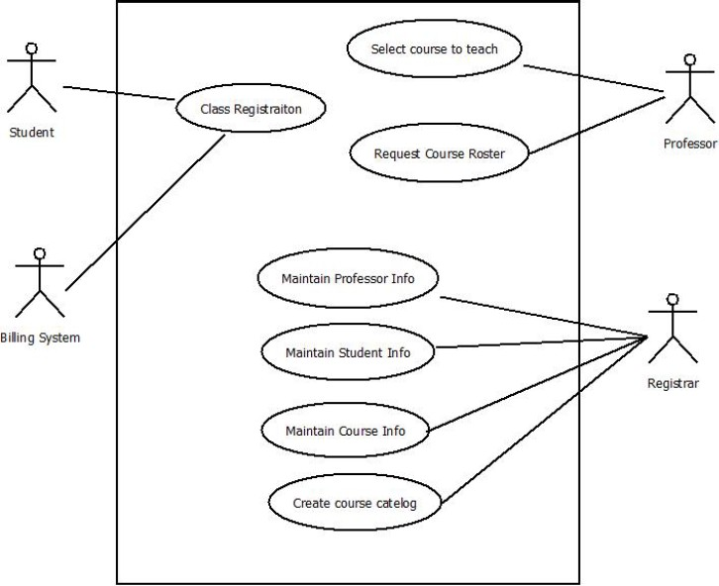
Example 2 cont.
Altered State University (ASU) Registration System

Slide 30
Example 3
Begin with a Use Case!
A user placing an order with a sales company might follow these steps :
Browse catalog and select items.
Call sales representative.
Supply shipping information.
Supply payment information.
Receive conformation number from salesperson.
Then translate Use Case sequence into Diagram

Slide 31
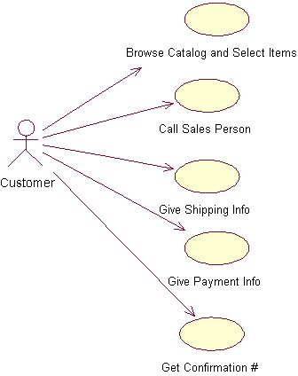
Example 3
The salesperson could also be included in this use case diagram because the salesperson is also interacting with the ordering system.

Slide 32
Example 4
Vending Machine
After client interview the following system scenarios were identified:
A customer buys a product
The supplier restocks the machine
The supplier collects money from the machine
On the basis of these scenarios, the following three actors can be identified:
Customer; Supplier; Collector (in this case Collector=Supplier)

Slide 33
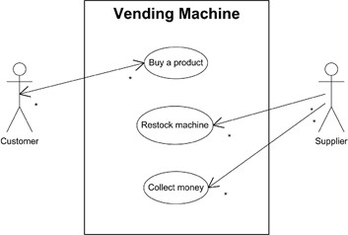
Example 4

Slide 34
Thank you

